Slide 1
Virtual Memory
Bùi Đức Hiếu - 7140231

Slide 2
Outline
  Virtual Memory
  Paged Virtual Memory
  Segment Virtual Memory
  Differences

Slide 3
Preface
Computers are running multiple processes with its own address space.
It's too expensive to create full address space for all process.
And each process use only small part of its address space.
Virtual Memory

Slide 4
Virtual Memory

Slide 5
Virtual Memory
Divides physical memory into blocks and allocates them to different processes.
Memory management technique is implemented using both hardware and software.

Slide 6
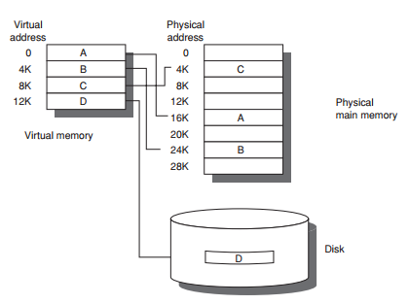
Virtual Memory
It maps memory addresses used by virtual addresses into physical addresses.

Slide 7
Benefit
Freeing applications from having to manage a shared memory space.
Increasing security due to memory isolation.
Being able to conceptually use more memory than might be physically available.

Slide 8
Category
Page (fixed-size blocks): 4096 to 8192 bytes
Segment (variable-size blocks): varies
  Min: 1byte
  Max: 2^16 - 2^32 byte.

Slide 9
Paged virtual memory

Slide 10
Paged virtual memory
Divide a virtual address space into pages, blocks of contiguous virtual memory addresses.
Systems with large virtual address ranges or amounts of real memory generally use larger page sizes.

Slide 11
Page table
Used to translate the virtual addresses seen by the application into physical addresses like MMU.
Each page table entry holds indexes whether the corresponding page is in real memory or not.

Slide 12
Page table
Yes, page table entry contain the real memory address at which the page is stored.
No, page fault exception.

Slide 13
Page supervisor
Creates and manages page tables.
If page fault exception, paging supervisor
  Accesses secondary storage
  Returns page has virtual address that resulted in the page fault
  Updates the page tables to reflect the physical location of the virtual address
  Tells the translation mechanism to restart the request.

Slide 14
Page supervisor
If physical memory is full, paging supervisor must free a page page.
Use one of page replacement algorithms to determine which page to free.

Slide 15
Segmented virtual memory

Slide 16
Segmented virtual memory
Dividing virtual address spaces into variable-length segments.
Consisting of a segment number and an offset within the segment.
Segmentation and paging can be used together by dividing each segment into pages.

Slide 17
Segmented virtual memory
Segment is not a page with variable length or a simple way to lengthen the address space.
Segmentation that can provide a single-level memory model in which there is no differentiation between process memory and file system consists of only a list of segments..

Slide 18
Differences between page and segment

Slide 19
Differences
About memory division.
Segmentation is visible to user processes.

Slide 20
Q & A

Slide 21
Thank you for attention

